Slide 1
Open wallet
Road To Devcon

Slide 2
Overview
The current overall experience of using Ethereum and Wallets is not very pleasant. This hinders its mass adoption and makes transactions prone to error.

Slide 3
Users need to manage their mnemonic/private keys and use public keys to make transactions
To a non technical user this process is very tedious.

Slide 4
For making making transactions users need to have public keys of recipient which increases the potential for mistakes.

Slide 5
The ever increasing time and gas prices have also made people to minimize crypto usage.

Slide 6
Features Of Our App
Easy and Hassle free onboarding process, using the much familier mobile number approach.
Transactions and token transferring can be also be done using mobile numbers.
Faster and cheap transactions with side chains.
Secure and Anonymous using the client side encryption for private keys as well as NuCypher Proxy Re-Encryption for mobile numbers.
Minimal interaction with blockchain components and still maximal decentralisation.

Slide 7
Findings
The SIM Card registration has a strict KYC policies which allow SIM cards to be taken as a good alternative to current public address systems.
Client Implications:
Added convenience of usage in countries with strict rules of KYCs for users.
Need of an extra layer of security like 2FAs for countries with lenient KYC policies to prevent hacks like SIM Card swaps
KYC
Non-KYC
150
46

Slide 8
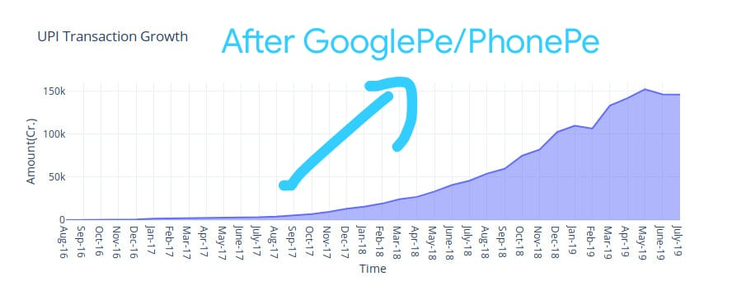
Market trends (India)

Slide 9
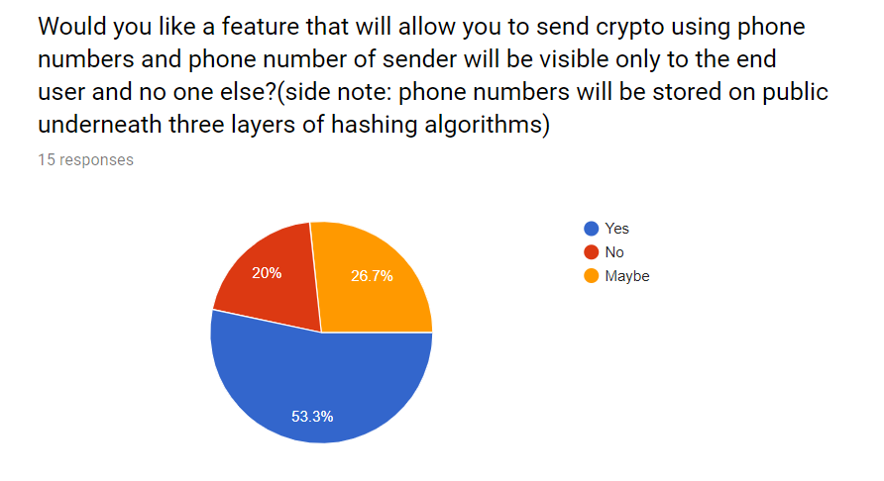
Potential User’s feedback

Slide 10
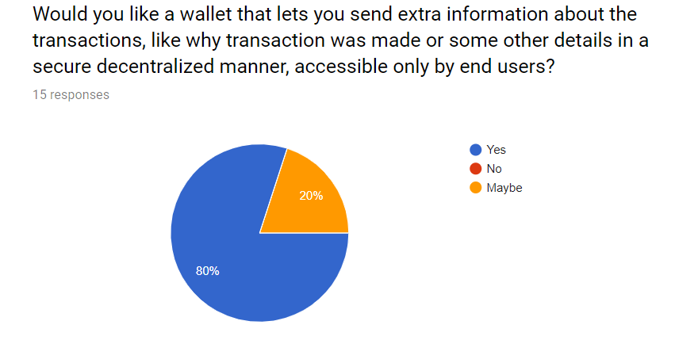

Slide 11
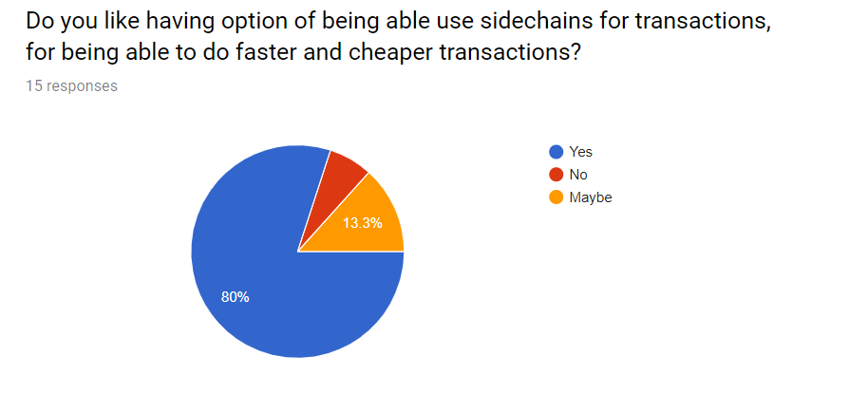

Slide 12
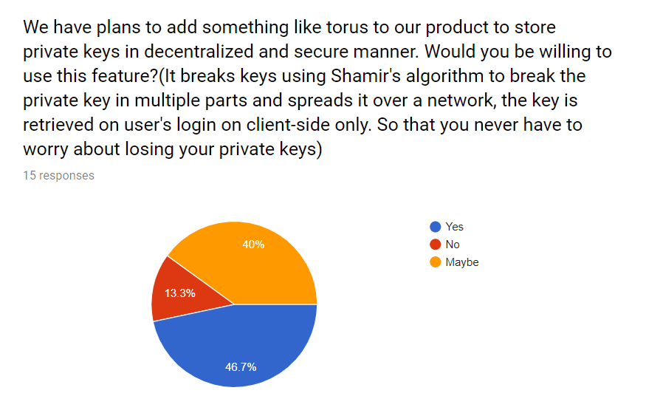

Slide 13
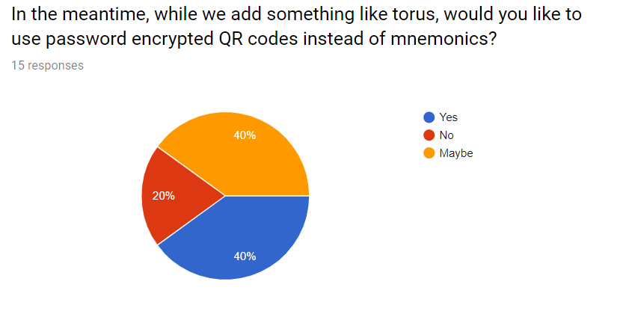

Slide 14
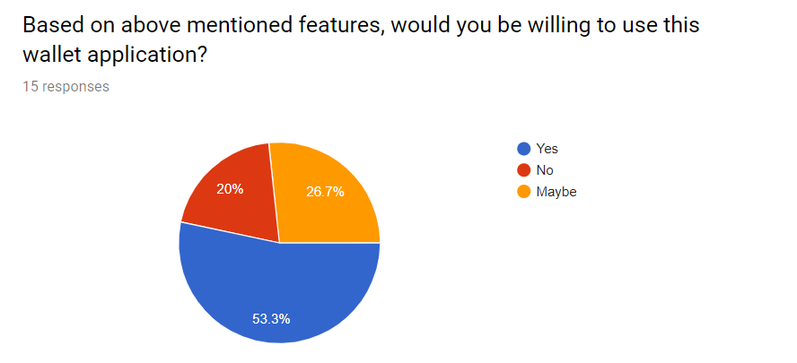
Lastly potential User’s willingness to use our wallet

Slide 15
These feedback included people from Algorand, Matic, ConsenSys, Gitcoin and some normal users

Slide 16
By 2020: 90 percent of smartphone users will have made a mobile payment. It’s estimated that by 2017, there will be $60 billion in mobile payment sales.
TechCrunch

Slide 17
Deliverables
Easy Onboarding
The user needs just a Mobile Number to get their Eth Wallet.
Easy To Use
Simplified process for Ethereum Transactions using mobile numbers. Moonpay to buy crypto on the go.
Faster/Cheap Transactions
Using the Matic Network network in a wallet topup methodology.
Privacy/Security
Using the NuCyper Proxy Re-Encryption for keeping the mobile numbers anonymous and sending extra information with transactions.

Slide 18
Some of Our Competitors
Company Name
Drawbacks
Portis
Uses Email Address for registration
Uses long addresses for making transactions
Fortmatic
Uses long addresses for making transactions
OTPs make it more centralised
Coinbase
Stores our Private Keys with themselves
Uses Email address for operation
Trust
Using mnemonics and private keys to manage accounts and long address for assets transfer

Slide 19



The Team
Abhimanyu Shekhawat
Sachin Mittal
Community Manager at GirlScript Summer of Code 19| Blockchain enthusiast| Android Developer| Flutter | Slither
Blockchain enthusiast | Blockchain Developer | Market Analyst| Open Source Enthusiast
Suraj Singla
Blockchain Déveloper | Solidity & EOS Déveloper

